Slide 1
Secured Country
CS-34
Presented by: Mina Gerges
Abanob Ashraf
Supervised By
Prof. Dr. Sherif Moharam
Assistant: Doaa Gamal
Manar EL-Shazly
2019-2020

Slide 2


Slide 3
Abstract
In this project, we purpose to develop a desktop application to save photos of people of whole country (National ID Photo) in some datasets which has the same information of the National ID Card then if this person done any criminal we can use our system to track this person via security cameras which placed in streets by government

Slide 4
Contents
01
Introduction
02
Analysis
03
Methodologies
04
Implementation & Results
05
Conclusion

Slide 5
Features
Problem definition
In our project we try to make it much easy to catch criminals, even if he didn’t caught on cam.
In the whole World it’s hard to catch criminal if there is no evidence harder if there are witnesses but they can’t prove it
Solution approach
we want to detect a lot of faces and recognition them even if there is no photo of criminal by taking features of the face from the witness.
Introduction & Overview

Slide 6
Analysis
Agile Approach
Why?
is a practice that promotes continuous iteration of development and testing throughout the software development lifecycle of the project.
Quick to build
Make it with the right features

Slide 7
Brainstorming Concept
Final Outline
After completing the brainstorming, we confirmed the ideas and the concepts to be formal, more organize as the following:
Civil Registry Officer
Knowledge Engineer
Blender Editor (Optional: If there is no photo of the criminal)
Police Officer
is a technique used by teams to bring out the ideas of each individual and present them in an orderly fashion to the rest of the team. The key ingredient is to provide an environment free of criticism for creative and unrestricted exploration of options or solutions. Also help team break free of old, ineffective ideas
Brainstorming

Slide 8
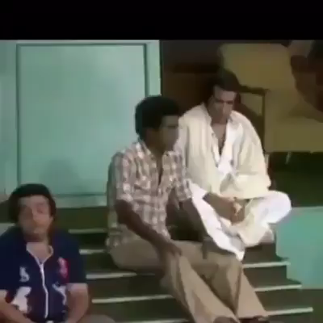

Slide 9
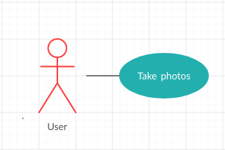
UML Diagrams

Slide 10
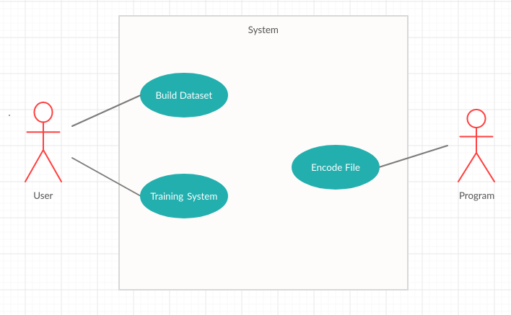

Slide 11
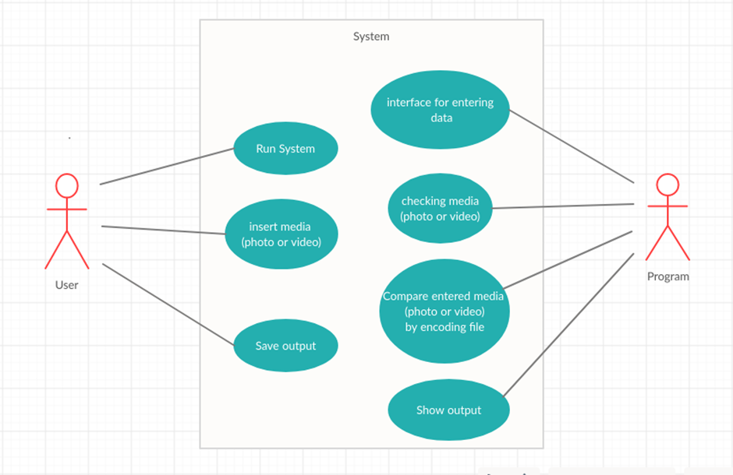

Slide 12

Methodologies

Slide 13
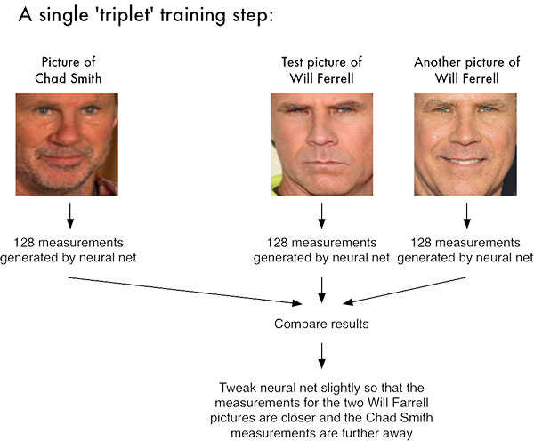
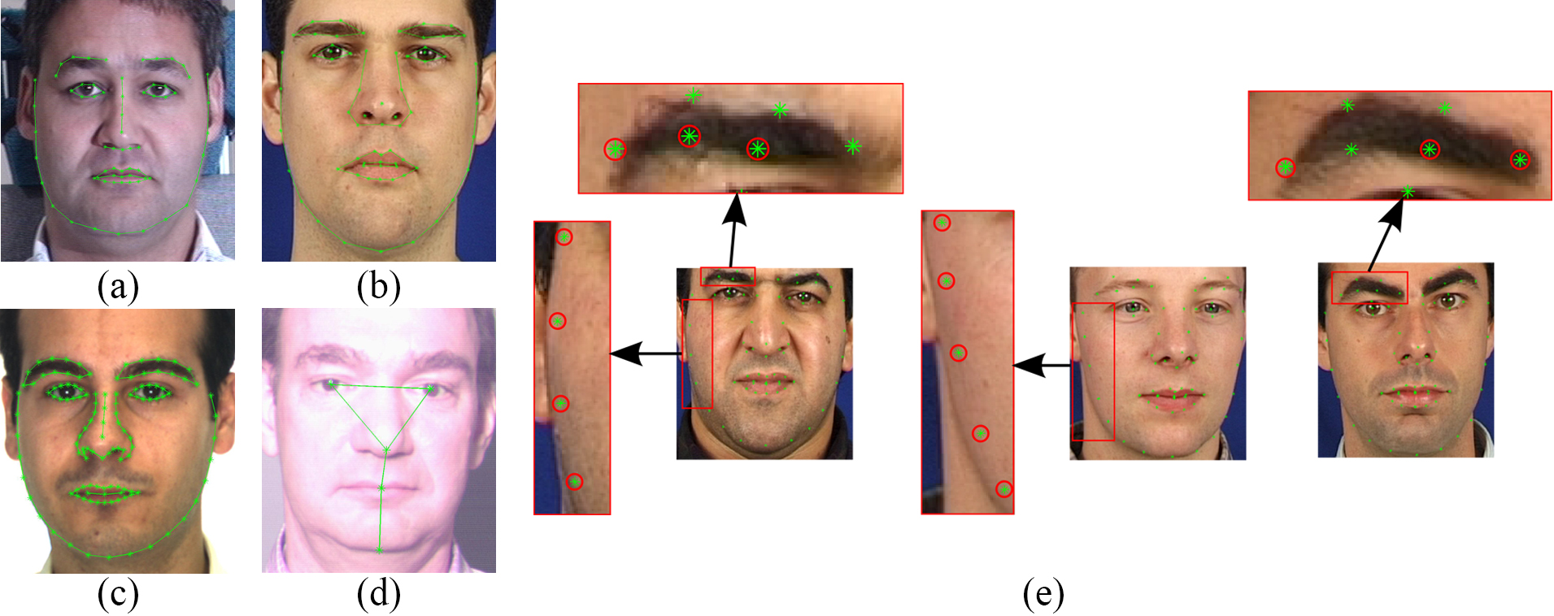
Why we use deep learning ?
This is how it works, While if we use Machine learning it will be harder.

Slide 14


The Ubuntu desktop is by far the world’s most widely used Linux workstation platform, powering the work of engineers across the globe. Ubuntu Core sets the standard for tiny, transactional operating systems for highly secure connected devices. Ubuntu Server is the reference operating system for the OpenStack project, and a hugely popular guest OS on AWS, Azure and Google Cloud.

Slide 15

is an interpreted, high-level, general-purpose programming language. Created by Guido van Rossum and first released in 1991, Python's design philosophy emphasizes code readability with its notable use of significant whitespace. Its language constructs and object-oriented approach aim to help programmers write clear, logical code for small and large-scale projects

Slide 16

OpenCV (Open Source Computer Vision Library) is an open source computer vision and machine learning software library. OpenCV was built to provide a common infrastructure for computer vision applications and to accelerate the use of machine perception in the commercial products. Being a BSD-licensed product, OpenCV makes it easy for businesses to utilize and modify the code.

Slide 17

Anaconda is a free and open-source[5] distribution of the Python and R programming languages for scientific computing (data science, machine learning applications, large-scale data processing, predictive analytics, etc.), that aims to simplify package management and deployment.

Slide 18

As a server-client application, the Jupyter Notebook App allows you to edit and run your notebooks via a web browser. The application can be executed on a PC without Internet access, or it can be installed on a remote server, where you can access it through the Internet.

Slide 19

CUDA® is a parallel computing platform and programming model developed by NVIDIA for general computing on graphical processing units (GPUs). With CUDA, developers are able to dramatically speed up computing applications by harnessing the power of GPUs.

Slide 20

is a free and open-source 3D computer graphics software toolset used for creating animated films, visual effects, art, 3D printed models, motion graphics, interactive 3D applications, virtual reality and computer games. Blender's features include 3D modeling, UV unwrapping, texturing, raster graphics editing, rigging and skinning, fluid and smoke simulation, particle simulation, soft body simulation, sculpting, animating, match moving, rendering, motion graphics, video editing, and compositing.

Slide 21
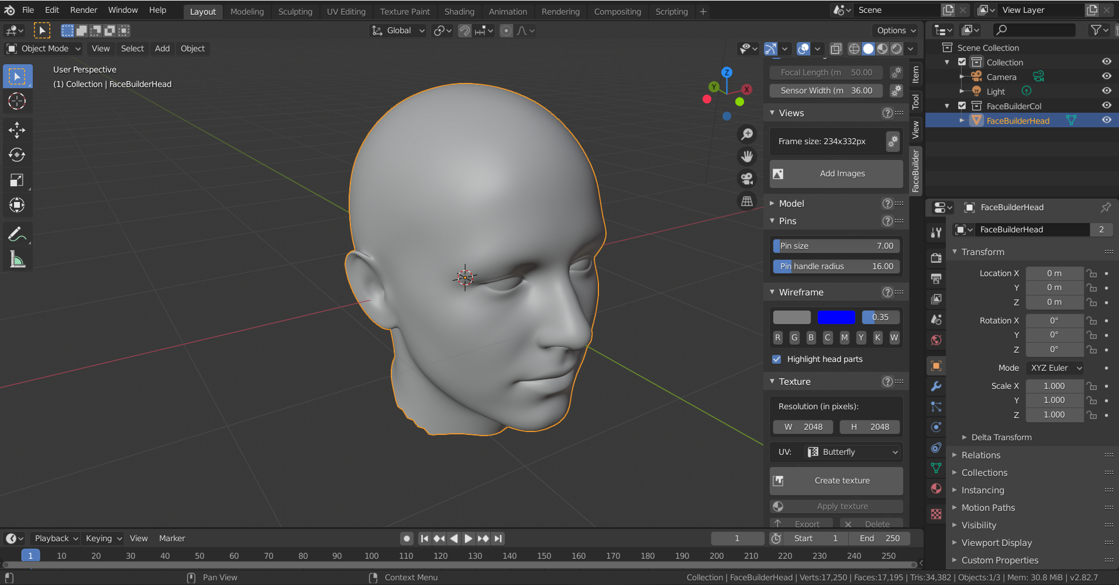

Slide 22
MTCNN
Haarcascade
Number of images in UTK Face: 24,111
Number of cropped faces using MTCNN: 21,666
Total number of extra faces from a single image: 428
Recall = (21666 / 24111)100 = 89.85%
Precision = (21238/21666)100 = 98.02%
Number of images in UTK Face: 24,111
Number of cropped faces using haarcascade: 19,915
Total number of extra faces from a single image: 947
Recall = (19915 / 24111)100 = 82.60%
Precision = (18968 / 19915)100 = 95.24%
Algorithm
In our Case We prefer to use MTCNN instead of Haarcascade ….. Why?

Slide 23
Implmentation & Results

Slide 24
Steps For Recognize faces
Feature Matching
Face ID
Feature Extraction
Face Alignment
Face Detection
OR
Traking
Aligned Faces
Face Location, Size & Pose
Image / Video
Datasets of enrolled users

Slide 25
We make our datasets of ourselves & our friends
Mina Gerges (6 images)
Abanob Ashraf (9 images)
Bassem Mohamed (7 images)
Ahmed Badry (4 images)
Alaa Mamdouh (4 images)
Ahmed Wanas (7 images)

Slide 26
After Encoding Faces of datasets
here’s a sample of encoding file

Slide 27
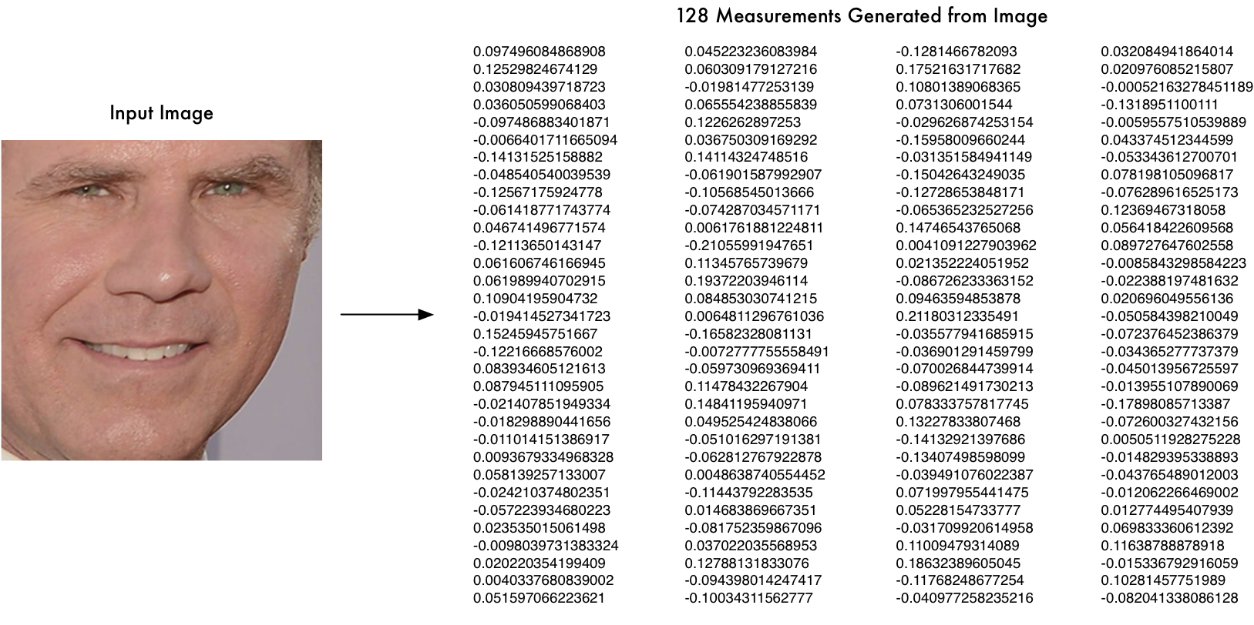

Slide 29
Results
Content Here
You can simply impress your audience and add a unique zing.

Slide 30
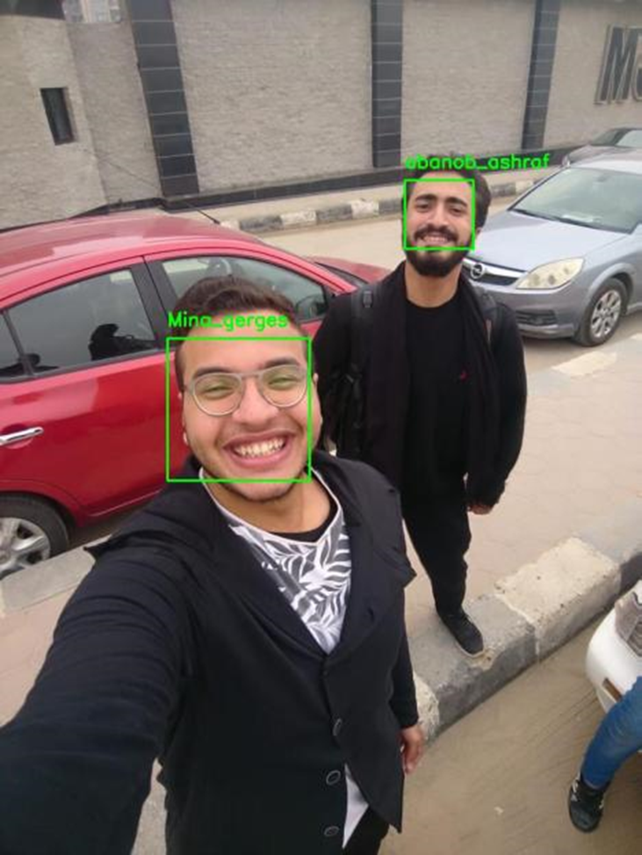

Slide 31
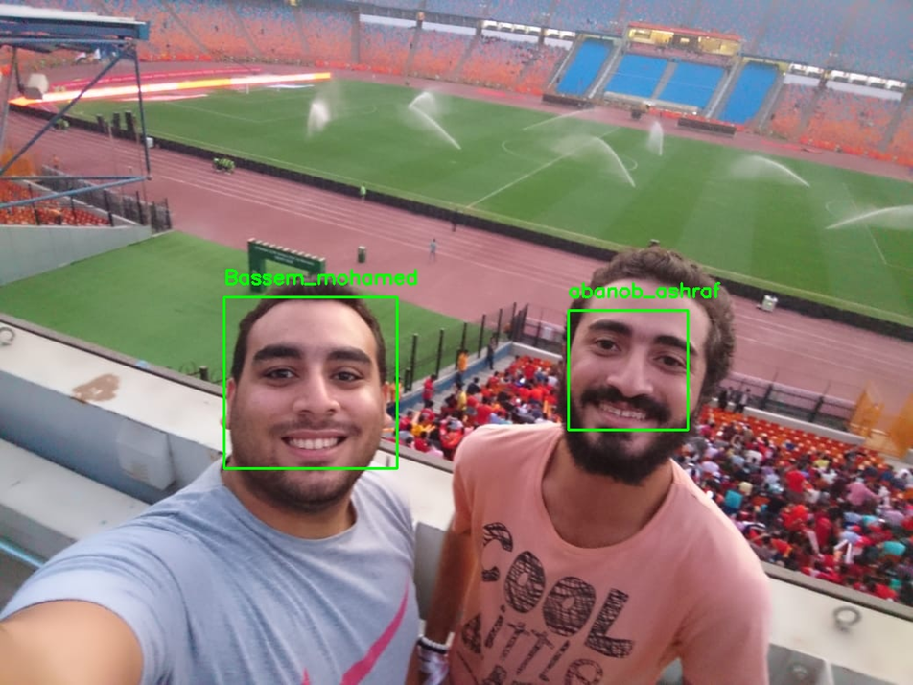

Slide 32
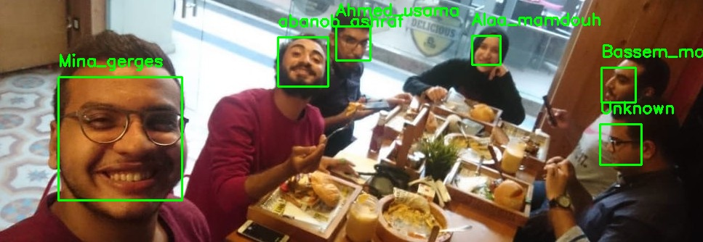

Slide 33
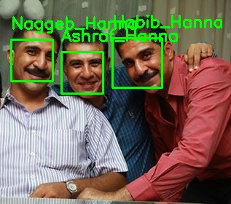

Slide 34
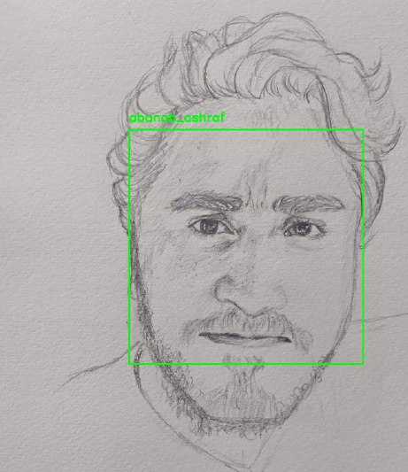

Slide 35
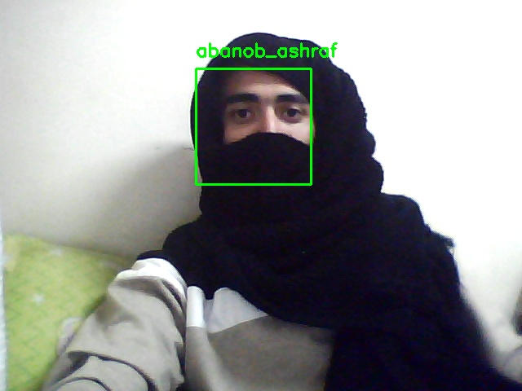

Slide 36
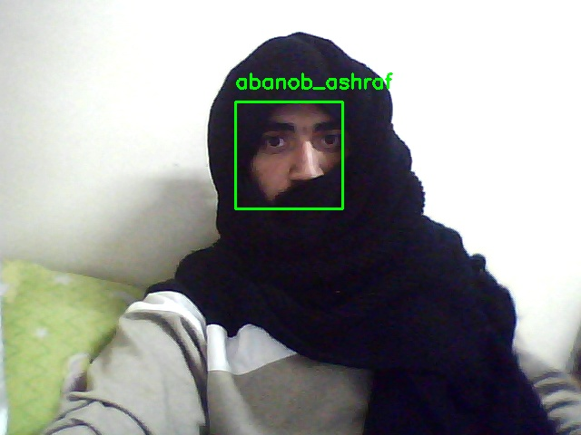

Slide 37
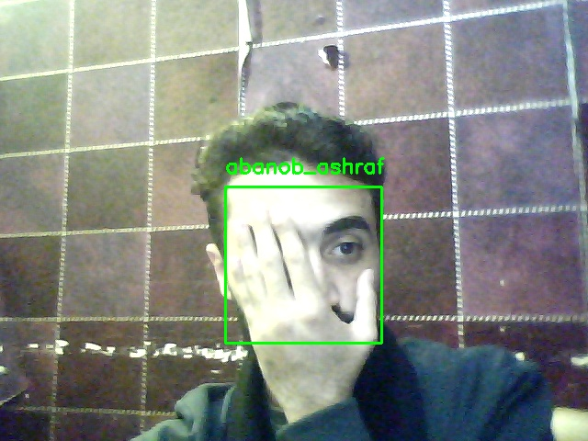

Slide 38
A face detection and recognition security system would certainly speed up the process of get the criminal caught in comparison to other traditional methods and in the right circumstances it would be able to match their accuracy. Nowadays there are a wide variety of software, whether it is a Face API like Microsoft’s or a library like OpenCV that makes face detection and recognition accessible and reliable and is constantly improving. Each software imposes various restrictions, such as the limited number of calls you can make to Microsoft’s Face API. However, using more than one software can reduce these restrictions and lead to better results.
Conclusion

Slide 39
train on special effects , draw the output , enhance the accuracy and performance
Future work

Slide 40
THANK YOU

